Slide 1
IDFC POC PROJCET
RAMAKRISHNA REDDY

Slide 2
Agenda
ICAAP-KRI AUTOMATION
Security compliance Report & Dashboard automation
RBI Audit Reports
Ciso Executive
Advanced Threat Protection
Security Operation Metrics
Automating False Negative incident removal using Demisto

Slide 3
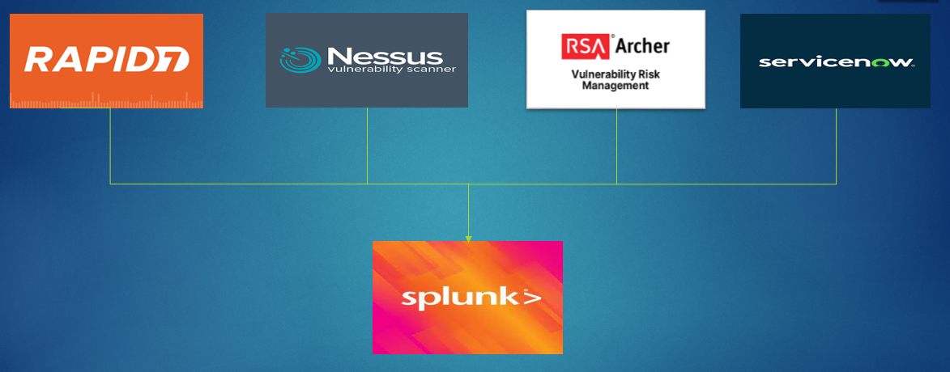
Splunk Add-ons Data integration

Slide 4
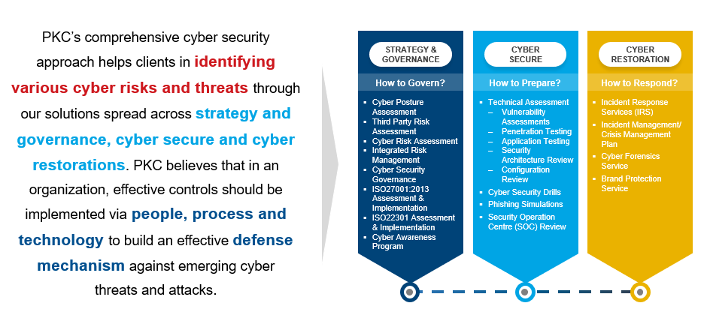
ICAAP
Internal capital adequacy assessment processes (the ICAAP) are at the heart of banks' capital management. Although ICAAP is purely an internal exercise, it plays a key role in the senior supervisory Manger of (SSM) banks providing input for the assessment of risks to capital as part of the annual Supervisory Review and Evaluation Process (SREP)

Slide 5
ICAAP Points
Number of open vulnerabilities on internet facing infrastructure(VA)
Total number of open MBSS points on critical application infrastructure(CA)
Percentage of application patches not applied for server( windows, Non-windows)
Percentage of applicable non critical patches including security patches not applied for end points in last 12 months (consider patches released by OEM)
Number of open vulnerabilities on internet facing application(App sec)

Slide 6
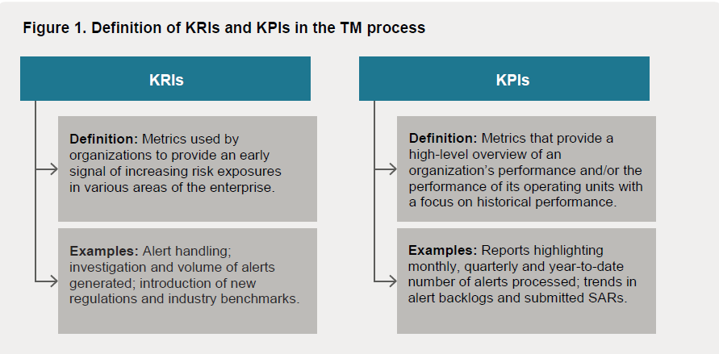
KRI/KPI
Percentage of applicable non critical patches including security patches not applied for end points with in 60 days of their release from end-points
Percentage of applicable non critical patches including security patches not applied for end points with in 60 days of their release for servers (windows)

Slide 7
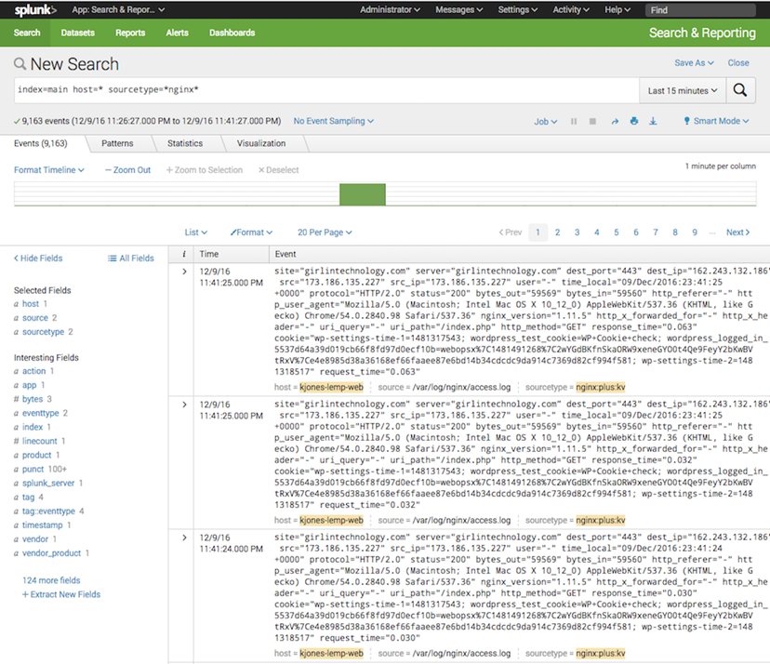
Raw logs

Slide 8
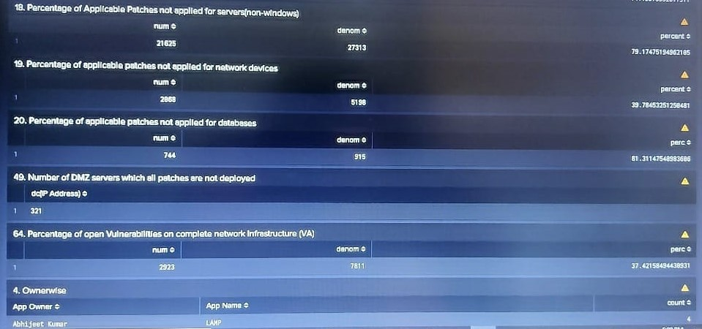
Logics & Dashboard
Index=“main” source=“va_may_22.csv” Family=“Data base” CVE=“*” Severity=“critical” Patch publication date=“*”
|eval days=strptime(‘patch publication date’, ”%B, %d,Y:H:M:S”)
|where days>=1690439400 AND days>=1624991400
|stats count(eval(status==“open”)) as num count as denom
|eval percent =(num*100)/denom

Slide 9
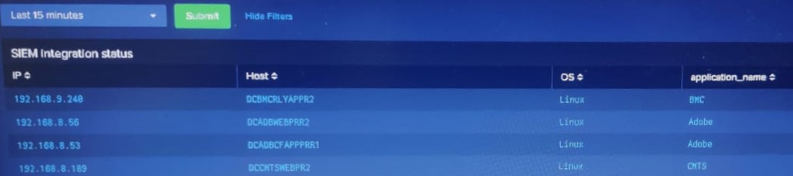
Audit Reports & Dashboard
SIEM integration status report dashboard(Monthly)
This report describes how to integrate the Privileged Access Manage solution with Security Information and Event Management (SIEM) applications.

Slide 10
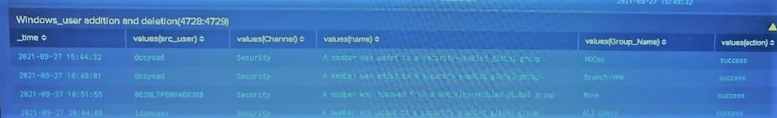
Windows user creation or deletion
A member was added to a security enabled global group
Branch VPN
None
All users
Qfmsallemp
A member was removed from a security enabled global group
The summary of the report describes the windows user addition and deletion from Members removed from a security enabled global group which channel, group particular event ID

Slide 11
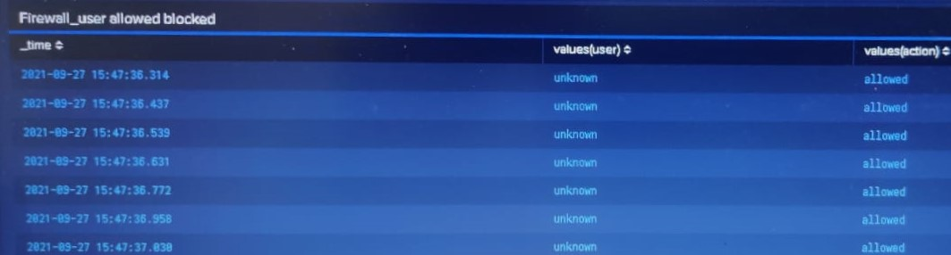
Fire wall user allowed are blocked(UTM, NAT, MLI)
Application-level Gateways (Proxy Firewalls)
Multi-layer Inspection (MLI) Firewalls
Network Address Translation (NAT) Firewalls
Cloud Firewalls
Unified Threat Management (UTM) Firewalls

Slide 12
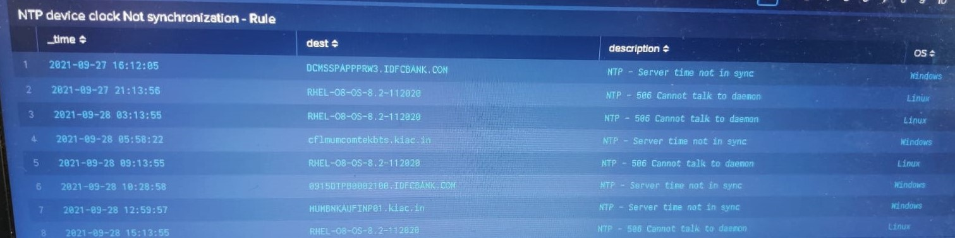
NTP device clock not synchronization- rule
The Network Time Protocol (NTP) is used to synchronize the time of a computer client or server to another server or reference time source
Analysis includes a predefined list of Symantec NTP servers
Attempts to connect to them in the order they appear in the NTP server list

Slide 13
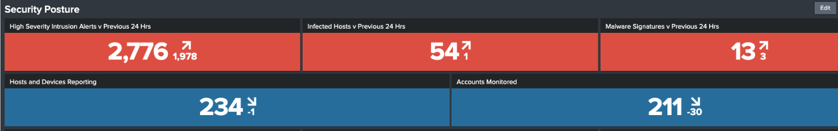
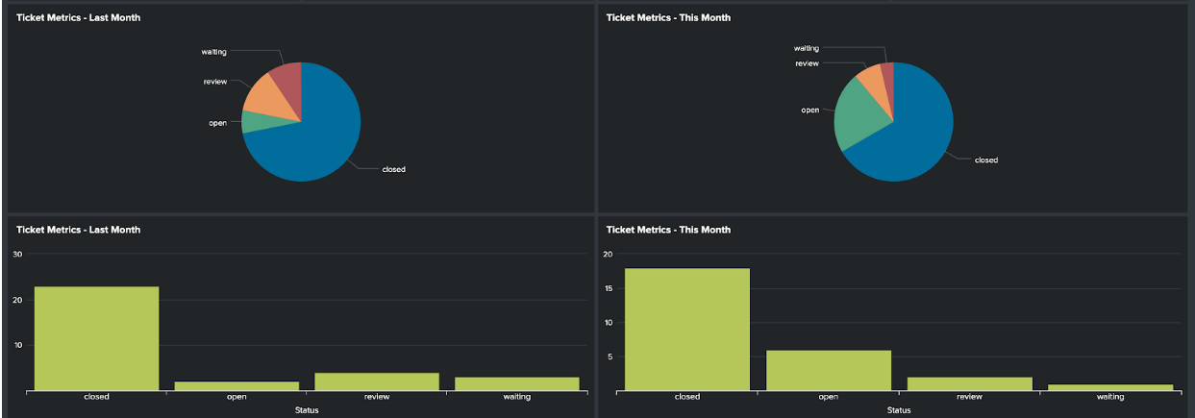
Ciso Executive dashboard
Security Posture dashboard provides a high-level view of your security posture. At the top of the dashboard there are two rows of indicators. The top-most row displays statistical counts of events covering your Intrusion Detection System (IDS), Antivirus and Malware systems. Each indicator shows the current state, with an arrow identifying the rate of change (positive, neutral, or negative) and the previously recorded statistic from 24 hours ago.

Slide 14
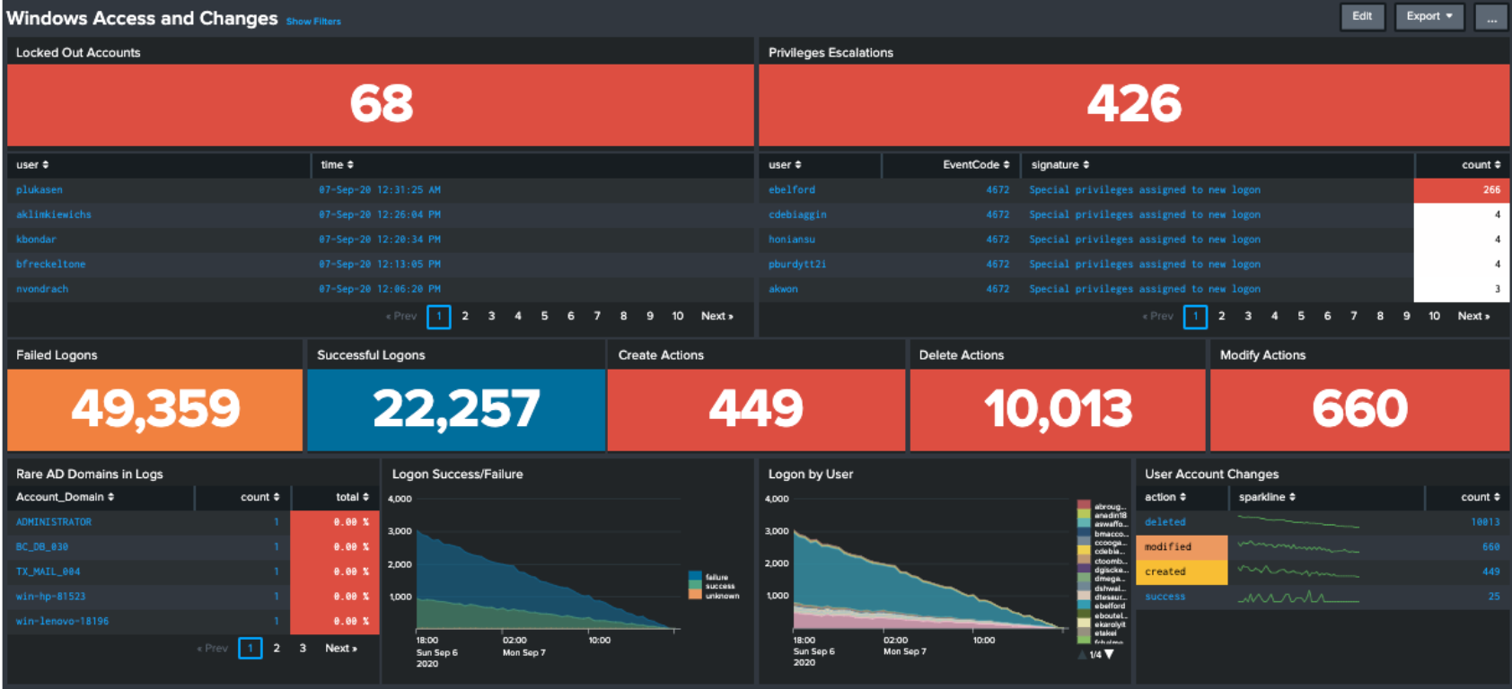
Windows Access and changes
Notes:
The Windows Access and Changes dashboard focuses on events within your Microsoft Windows environment. It displays information relating to:
Locked Out Accounts
Privilege Escalations
Change metrics
Authentication metrics

Slide 15
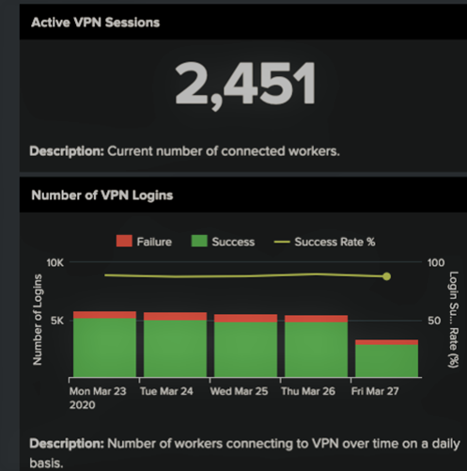
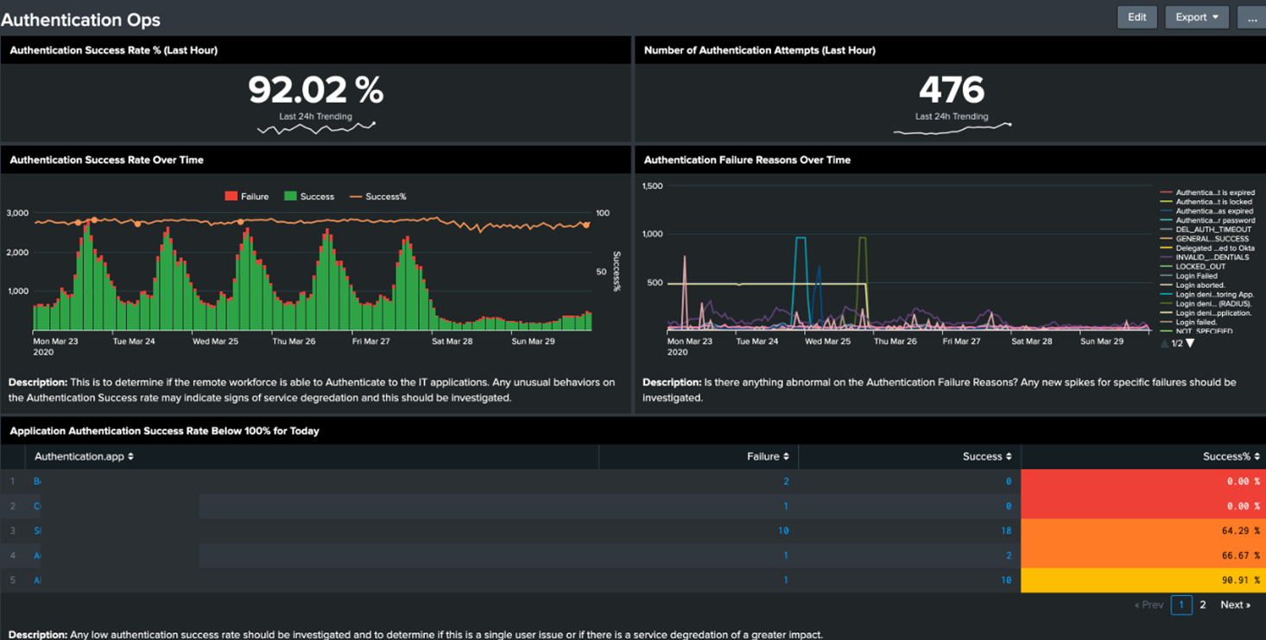
VPN, Authentications Ops

Slide 16
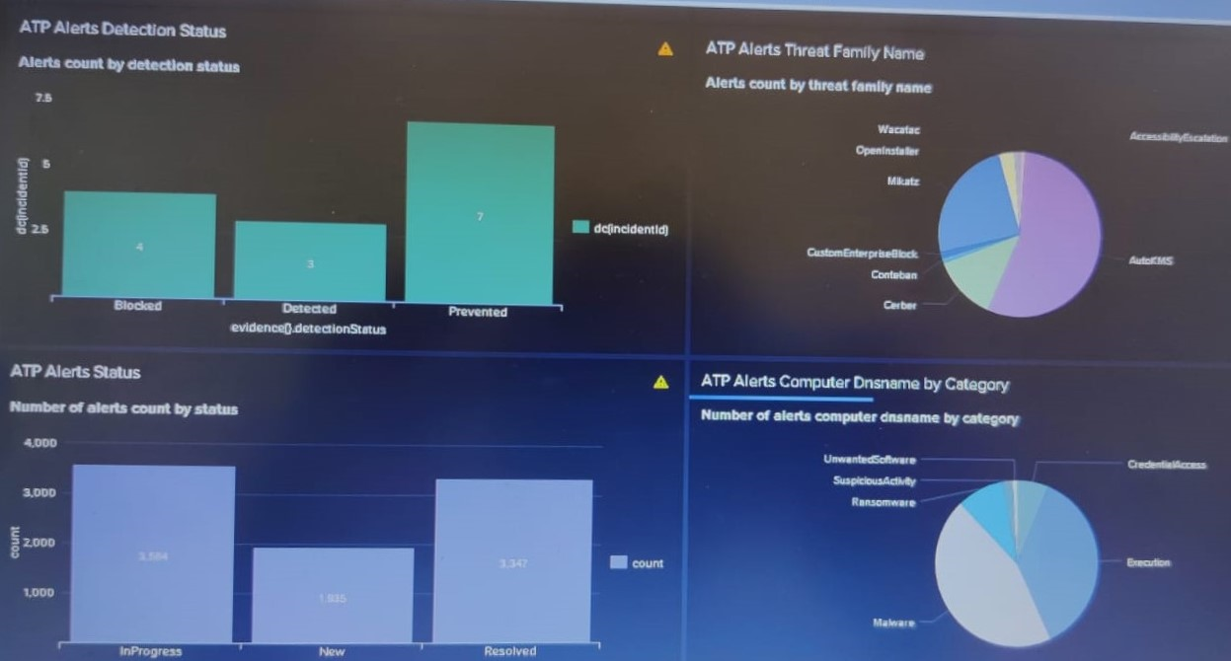
Advanced Threat Protection (ATP)
Advanced Threat Protection is a security solution that defends against complex malware or hacking attacks that target sensitive data within an organization. Protect against advanced threats with the industry’s most robust email security platform and the most accurate view of the email threat landscape.

Slide 17
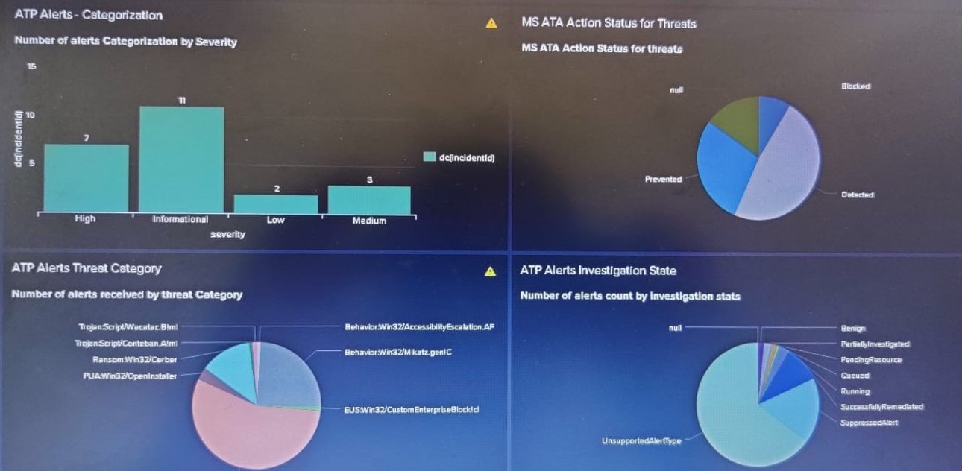
ATP Alerts, Action, Threat, Category, Investigation
This Dashboard describes about alerts categorization by severity, action status for threats, threat category, and investigation state count.
Notes:
This Dashboard describes about alerts categorization by severity, action status for threats, threat category, investigation state count.

Slide 18
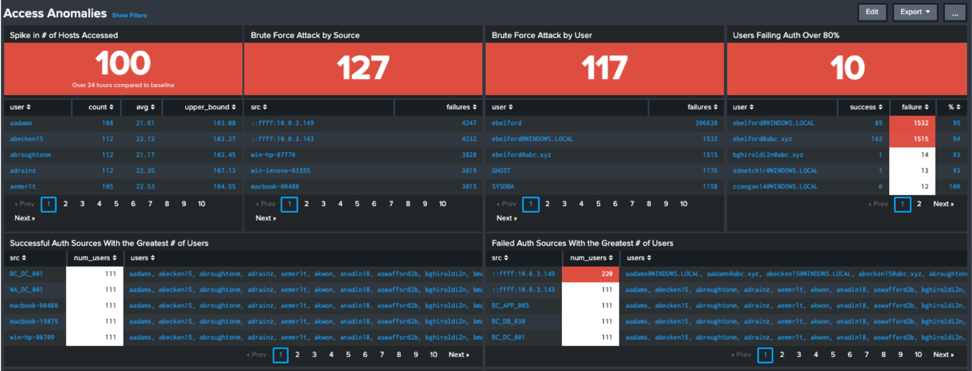
Security operation metrics
The Access Anomalies dashboard identifies events that could potentially pose a security risk. Searches look to identify:

Slide 19
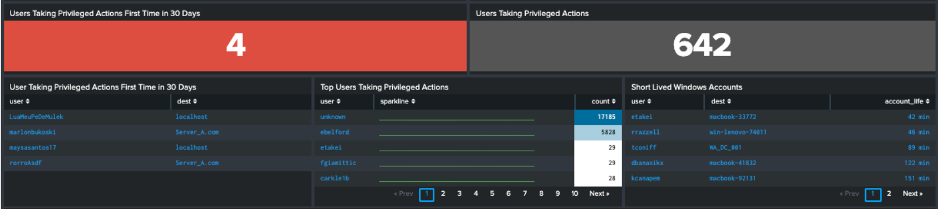
Privileged Actions
Spikes or out of character increases in access to hosts
Brute force attacks by source or user
Accounts that have high percentage of logon failures vs success
Users performing new privileged actions
Geographically improbably access

Slide 20
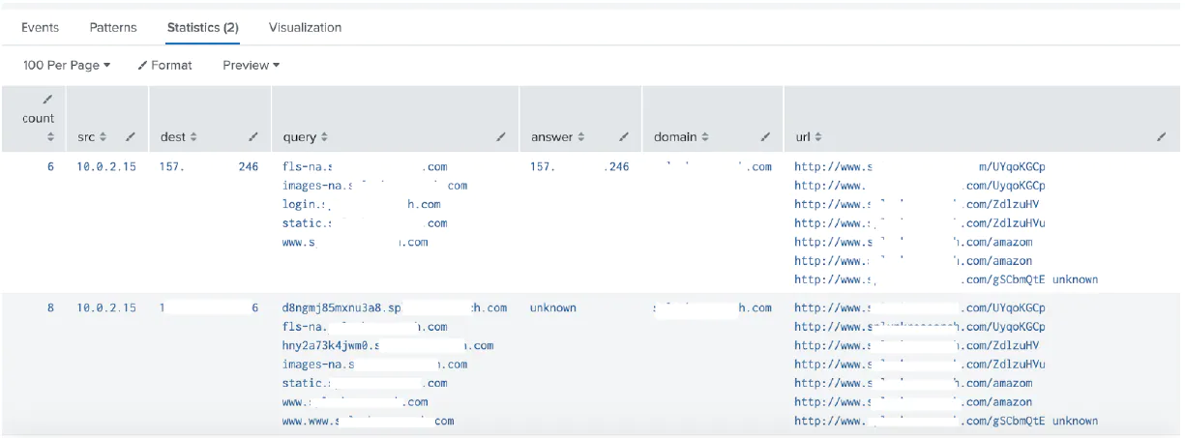
One to one emails recipient should be public domain ID(Gmail, outlook, yahoo)

Slide 21
Automating False Positive incident removal using Demisto
Developed a python code from scratch incorporating Notable event API and tested it in Pycharm IDE
Troubleshoot the above code in Demisto by exploring python-Unix compatibility tried to resolve the above issue by running the code using Demisto-Py-chram Plugin

